Slide 1

Human Capital Management System
By Datanauts

Slide 2
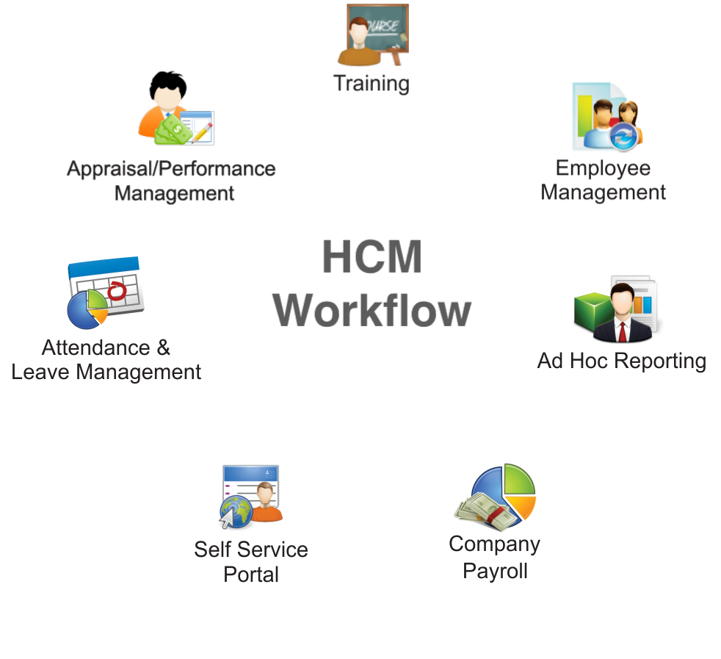

Slide 3

Primary Actors
Employee- Manage and view his demographic/Job/Payroll data.
Project Manager- Manage, assign projects and recommend competency level trainings to a particular employee. He can also generate reports to review employee performances.
HR admin- Manages the recruitment process, tracks attendance and absence records of employees. HR admin can also guide company in forecasting the necessary onboarding or layoff activities as well as process payroll by Calculating the total earnings, deductions, taxes and net pay amounts based on HR data
Analyst- Analyzing the performance of the company in terms of project allocation, performance factors and other human resource duties.

Slide 4

UML
UML

Slide 5
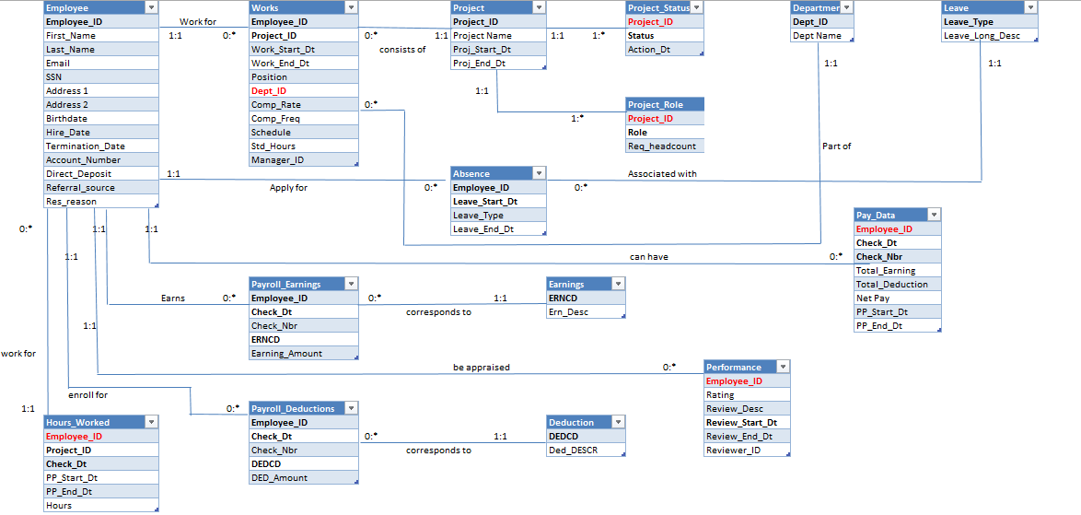

Slide 6
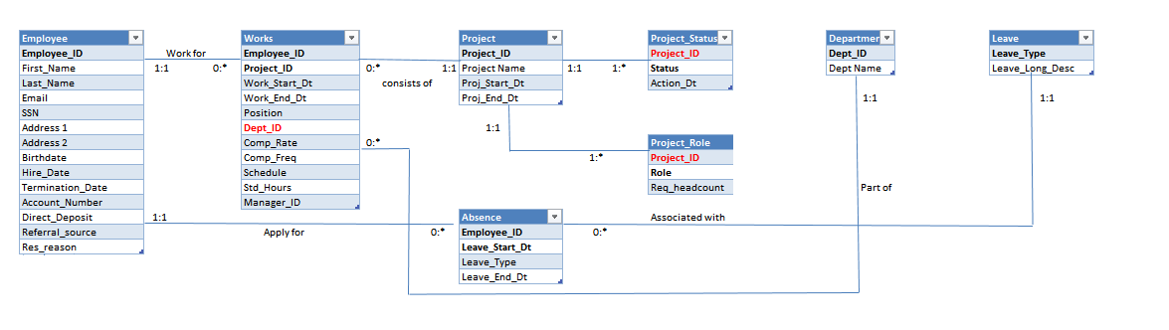

Slide 7
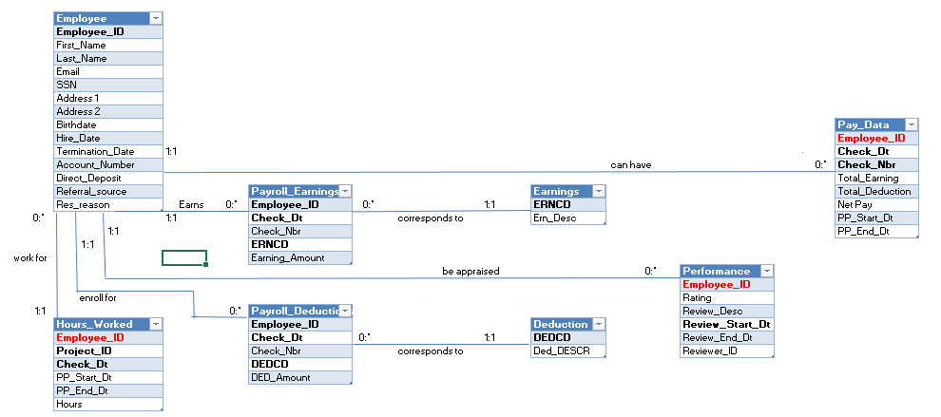

Slide 8
Business Metrics
Time to fill Position: Total number of days for filling up a new job opening
Bench time for an employee
Percentage of employees who resigned due to lower compensation
Best source of referral
Staffing cost: Basic pay, bonus etc.
Utilization per project/employee

Slide 9
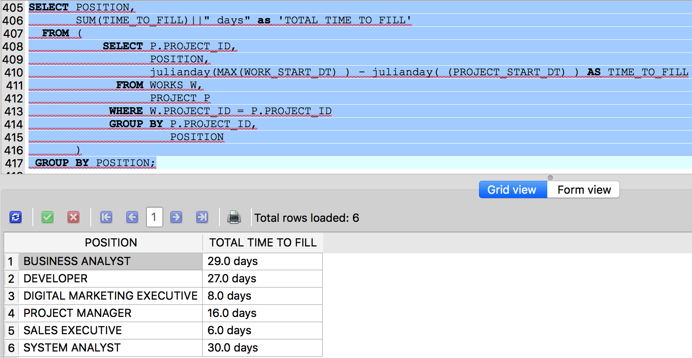

Slide 10
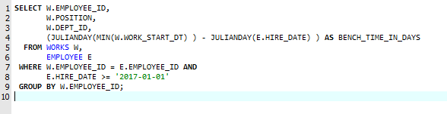

Slide 11
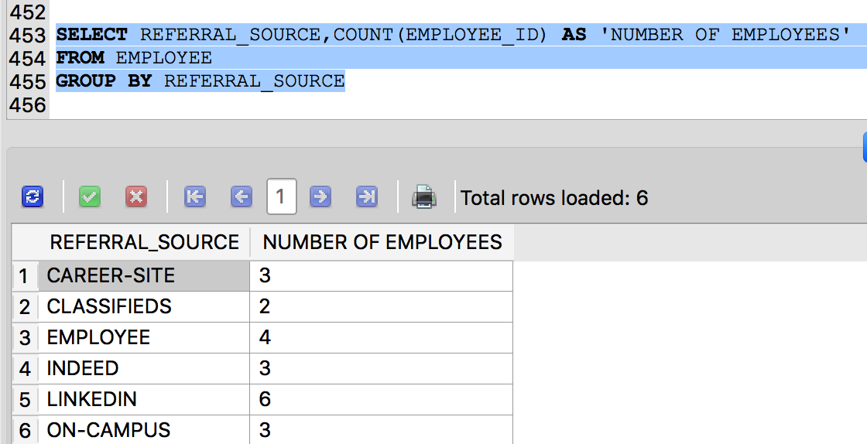

Slide 12
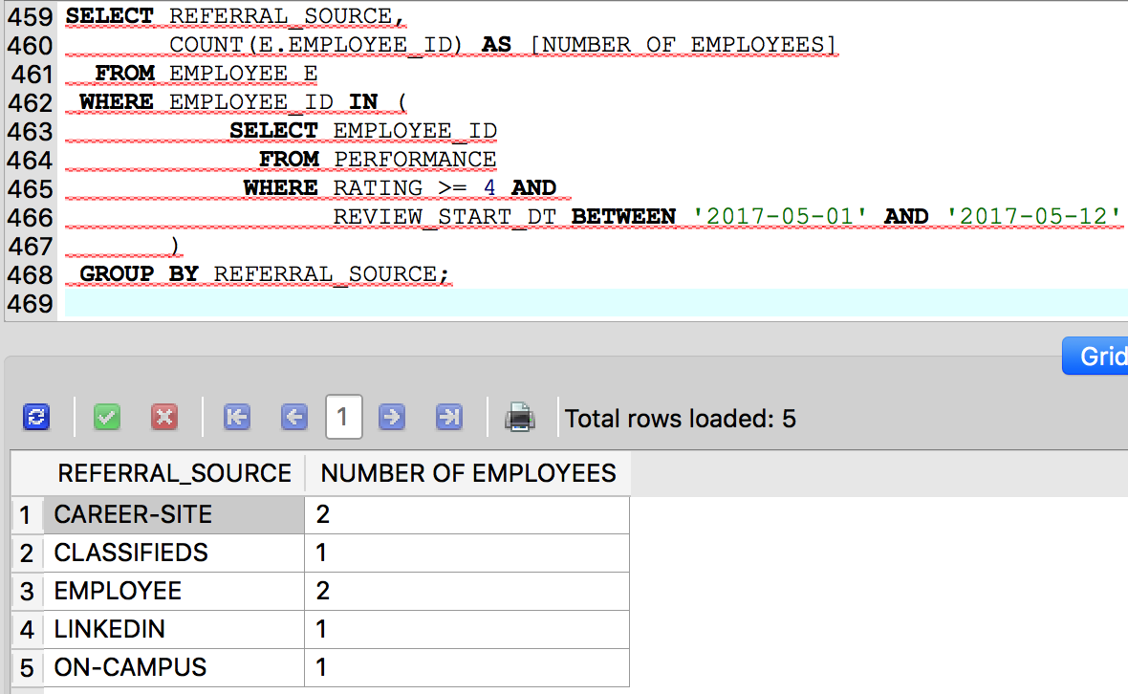
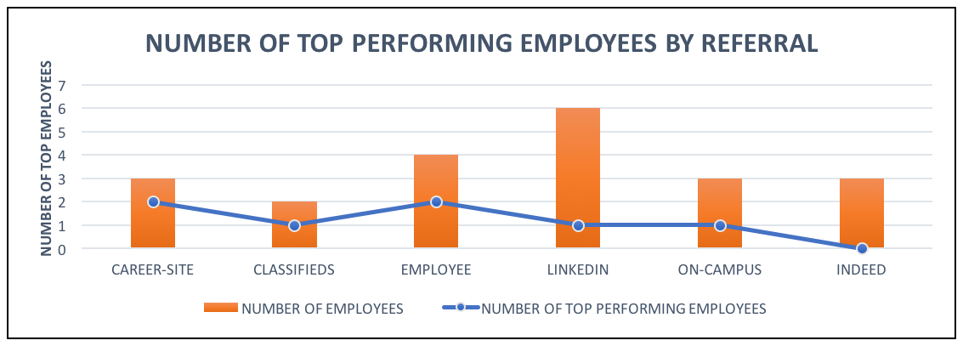

Slide 13
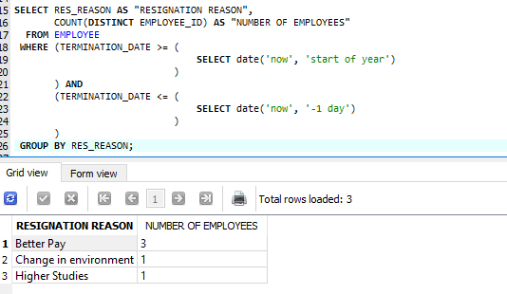

Slide 14
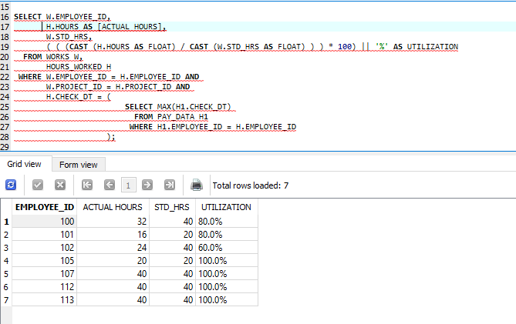

Slide 15
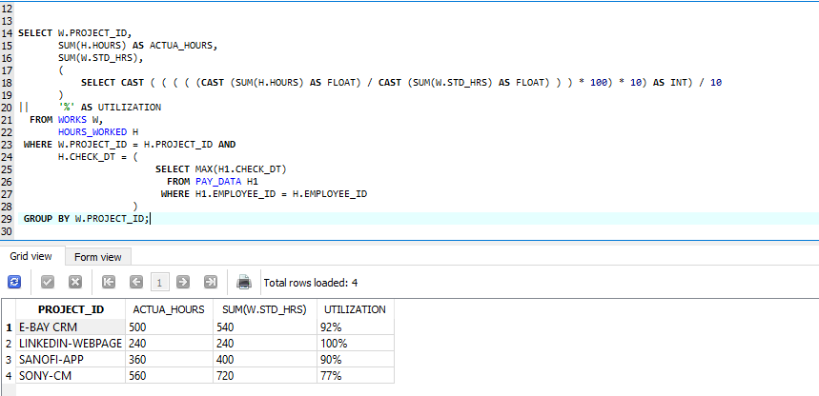

Slide 16
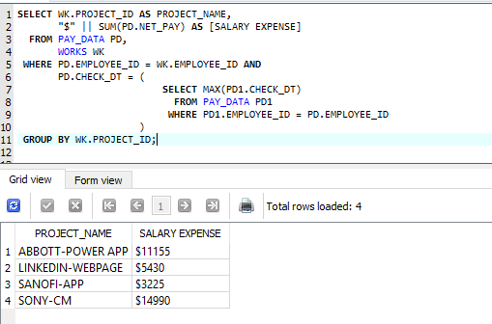

Slide 17
Learning and Experiences
Scoping
Estimation
Schema Designing
Metrics(Analytical)

Slide 18
Problems and Solutions
Scoping: Accommodating main aspects of HCM into very few tables
System challenges: SQLite date functions, different query syntax
Test data: Different date formats, maintaining consistency throughout the database

